Slide 1




NEXT GEN EMPLOYABILITY PROGRAM
Creating a future-ready workforce
Team Members
College Name
Student Name : Denshiga Dhas C.A
Student ID : au960221104048
Arunachala College of Engineering for Women

Slide 2

CAPSTONE PROJECT SHOWCASE
Project Title
Car Rentals Application with Django Framework
Abstract | Problem Statement | Project Overview | Proposed Solution | Technology Used | Modelling & Results | Conclusion

Slide 3
Abstract
The envisioned web application, built on Django, aims to revolutionize the car rental industry by providing a comprehensive solution for managing rentals, bookings, and customer data. Customers will have the convenience of searching for available cars, making bookings, and maintaining their profiles seamlessly. The system will also streamline inventory tracking, ensuring optimal utilization of resources and timely replenishment. Additionally, robust reporting functionalities will empower the company with valuable insights for strategic decision-making and business growth. Through intuitive design and efficient functionality, this application will set a new standard for car rental management, enhancing customer satisfaction and operational efficiency.
Source :

Slide 4
Problem Statement
A car rental company wants to develop a web application using the Django framework to manage their car rentals, bookings, and customer information. The application should allow customers to search for available cars, make bookings, and manage their profiles. Additionally, the company wants to track their inventory and generate reports for business analysis.
Source :

Slide 5
Project Overview
1.User Interface:
Allow customers to search, book, and manage profiles.
2.Payment Integration:
Seamless transactions during bookings.
3.Inventory Tracking:
Monitor car availability in real-time.
4.Key Features:
Manage car rentals, bookings, and customer information.
5.Security:
Implement secure authentication and data protection
6.Responsive Design:
Compatibility with various devices
7.Goal:
Enhance efficiency and customer experience for the car rental company
Source :

Slide 6
Proposed Solution
1.Project Setup and Configuration :​
Start by creating a new Django project and configuring the necessary settings, such as database, applications, and middleware. This step involves installing Django and setting up the project structure, including virtual environments and package installations.​ ​
2.Data Model Design :
Define the data models for Cars, Customers, Bookings, and any other relevant entities. These models will represent the tables in the database and will be used to store and retrieve data. Create appropriate relationships between models and define any necessary field.
3.Web Application Development :
Create the necessary views, templates, and URLs to handle user interactions, such as searching for available cars, making bookings, and managing profiles. Develop the application's front-end and back-end components to ensure smooth user experience and functionality.
Source :

Slide 7
4. Car Listing :
Develop a view that displays a list of available cars. This view should be connected to the Car model and should fetch the cars from the database. Implement a search functionality to allow users to filter cars based on various criteria, such as car type, location, and availability.
5.Booking System :
Design a system that allows users to make bookings. This should include a form where users can select a car, choose dates, and provide their contact information. Upon successful submission, the system should create a new booking entry in the database and update the car's availability accordingly.
6.Customer Management :
Create a feature that enables customers to manage their profiles. This should include a form where customers can update their personal information, such as name, address, and contact details. Implement user authentication and authorization to ensure only registered users can access and modify their profiles.
Source :

Slide 8
7. Inventory Tracking :
Implement a system to track the company's inventory. This should involve updating the availability of cars in real-time as bookings are made or cancelled. Develop a background process or signal to automatically update the car availability in the database.
8. Reporting System :
Develop a reporting system that generates business analytics, such as the number of bookings, revenue, and car utilization. Create necessary views and templates to display these reports and enable users to download or print them.
9.Deployment, Security, and Maintenance :
Once the application is developed and tested, deploy it to a web server or cloud platform for public access. Ensure the application is secure by implementing necessary security measures, such as user authentication, authorization, and encryption of sensitive data. Additionally, ensure the application is scalable to handle increased traffic and user load. Perform thorough testing to identify and fix any bugs or issues.
Source :

Slide 9


Technology Used
Front-end
Back-end
Source :

Slide 10
Modelling & Results
Modelling
Entities: Customer, Car, Booking, Inventory, Report
Attributes: Customer (ID, Name, Contact Info), Car (ID, Model, Make, Year, Availability), Booking (ID, Customer ID, Car ID, Start Date, End Date), Inventory (Car ID, Quantity), Report (ID, Type, Date, Data)
Relationships: Customer has Booking, Car has Inventory, Booking has Car, Report contains data
Results
User-Friendly Interface: Design an intuitive and responsive web application for easy navigation and seamless user experience.
Inventory Tracking: Monitor car availability, update inventory based on bookings, and notify low stock.
Payment Integration: Integrate payment gateways for online booking payments.
Car Search & Booking: Enable customers to search for available cars by date and location, select a car, and make a booking.
Source :

Slide 11
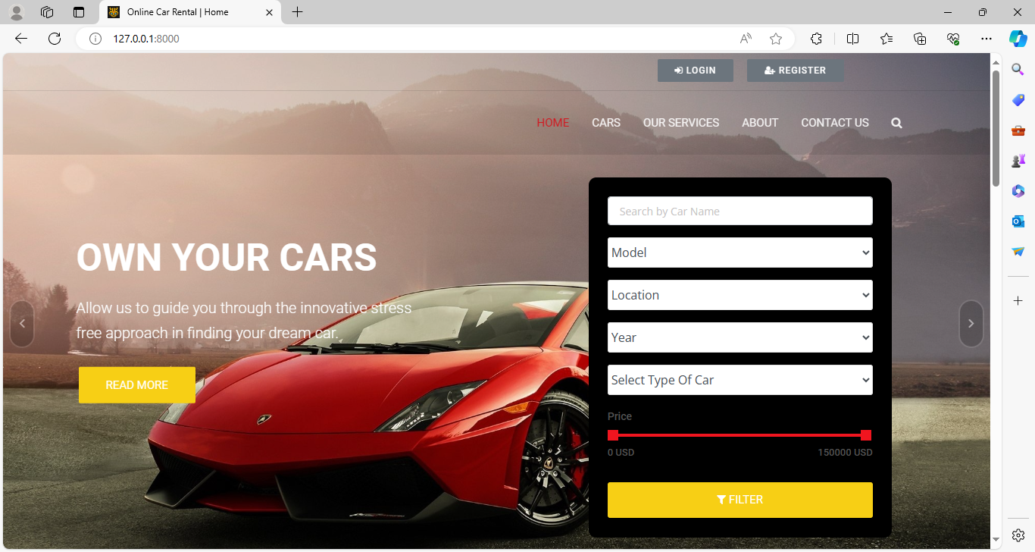
Homepage

Slide 12
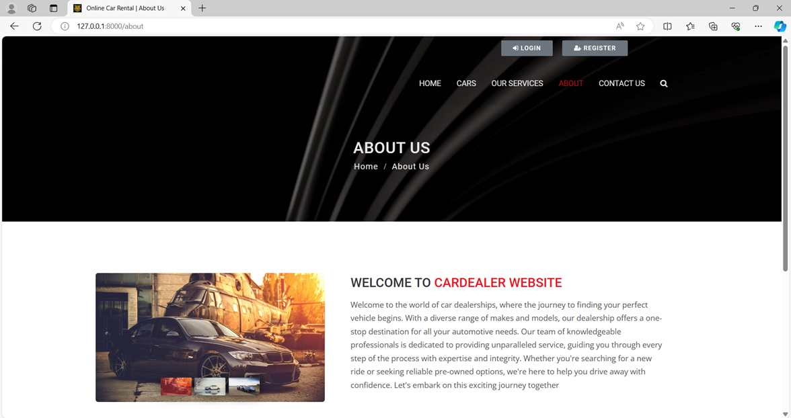
About-Us-Page

Slide 13
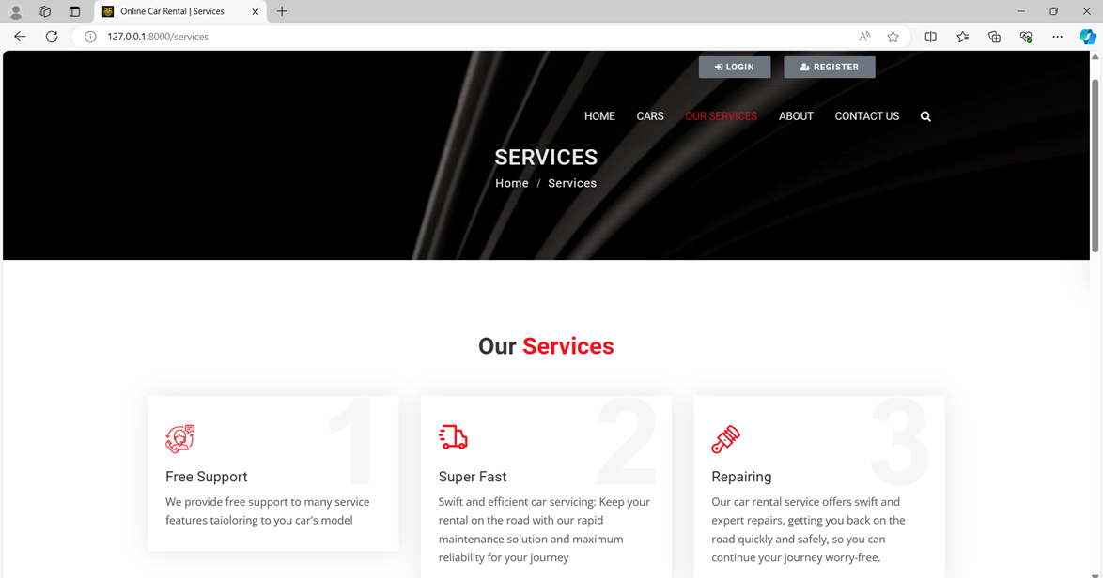
Service-Page

Slide 14
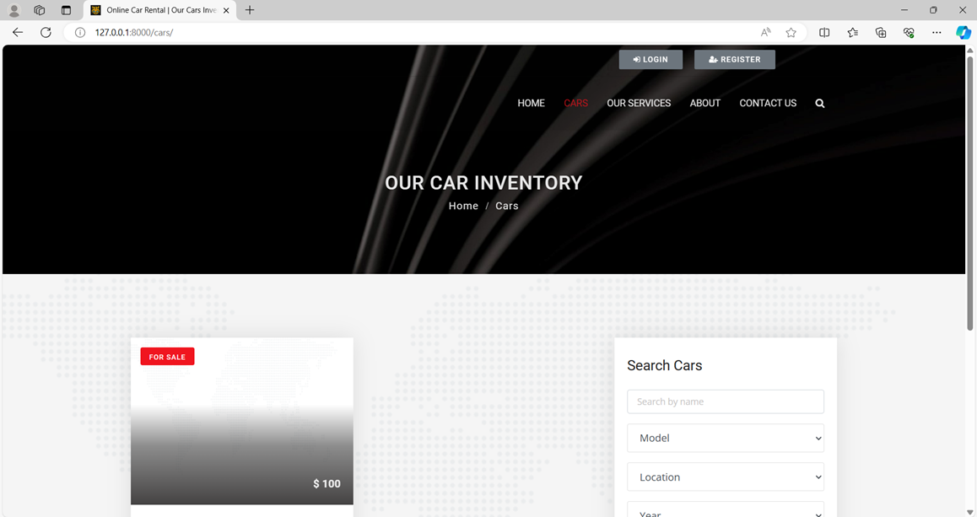
Cars-Page

Slide 15
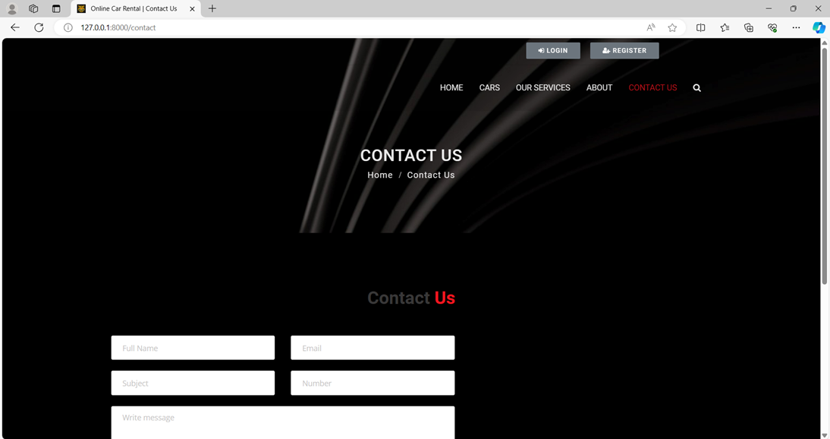
Blog-Page

Slide 16
Future Enhancements:
Recommendation Engine: Develop a recommendation system based on user preferences and past bookings.
Customer support Chatbot: Incorporate AI-powered chatbots to handle customer queries and support requests.
Social Media Integration: Enable social media login and sharing options for enhanced user engagement.
Notification System: Implement email or SMS notifications for booking confirmations, reminders, and updates.
Dynamic Pricing: Implement dynamic pricing based on demand, seasonality, and availability.
Geolocation Services: Integrate geolocation services to offer nearby car pickup/drop-off options.
Fleet Expansion: Add support for additional vehicle types such as trucks, vans, or luxury cars.
Payment Integration: Integrate payment gateways for seamless online transactions.

Slide 17
Conclusion
In summary, by harnessing the Django framework, the car rental company can create a comprehensive web application to seamlessly handle car rentals, bookings, and customer data. This platform will empower customers to easily search, book, and manage their profiles while enabling the company to efficiently track inventory and generate insightful business reports.
Source :

Slide 18
Thank You!
Notes:
Thank You !!

